Slide 1
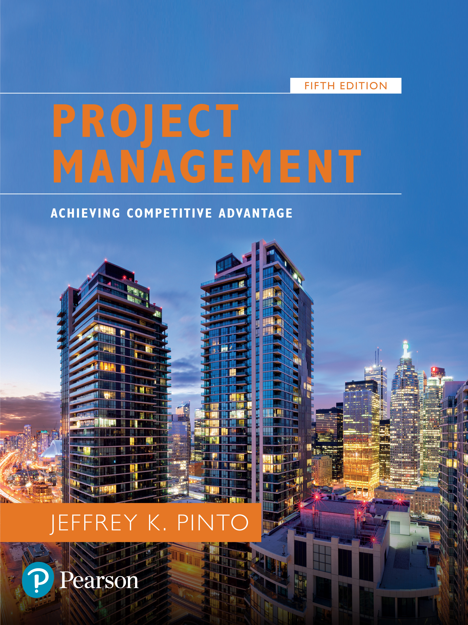
Project Management: Achieving Competitive Advantage
Fifth Edition
Chapter 7
Risk management
Copyright © 2019, 2016, 2013 Pearson Education, Inc. All Rights Reserved
Notes:
If this PowerPoint presentation contains mathematical equations, you may need to check that your computer has the following installed:
1) MathType Plugin
2) Math Player (free versions available)
3) NVDA Reader (free versions available)

Slide 2
Learning Objectives
7.1 Define project risk.
7.2 Recognize four key stages in project risk management and the steps necessary to manage risk.
7.3 Explain the Project Risk Analysis and Management (P R A M) process.

Slide 3
Questions to Consider in Risk Management
What is likely to happen (the probability and impact)?
What can be done to minimize the probability or impact of these events?
What cues will signal the need for such action (i.e., what clues should I actively look for)?
What are the likely outcomes of these problems and my anticipated reaction?

Slide 4
Risk Management
Risk management—the art and science of identifying, analyzing, and responding to risk factors throughout the life of a project and in the best interest of its objectives.
Project risk—an uncertain event or condition that, if it occurs, has a positive or negative effect on one or more project objectives such as scope, schedule, cost, or quality.

Slide 5
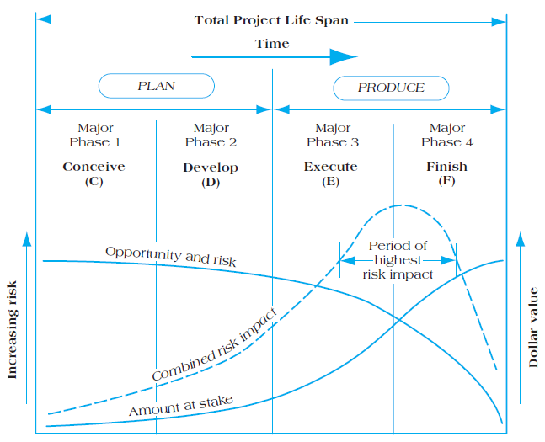
Figure 7.2 Risk Versus Amount at Stake: The Challenge in Risk Management

Slide 6
Four Stages of Risk Management
Risk identification
Analysis of probability and consequences
Risk mitigation strategies
Control and documentation

Slide 7
Risk Clusters
Financial
Technical
Commercial
Execution
Contractual or legal risk
Common Types of Risks
Absenteeism
Resignation
Staff pulled away
Time overruns
Skills unavailable
Ineffective training
Specs incomplete
Change orders

Slide 8
Risk Factor Identification
Brainstorming meetings
Expert opinion
Past history
Multiple (or team-based) assessments

Slide 9
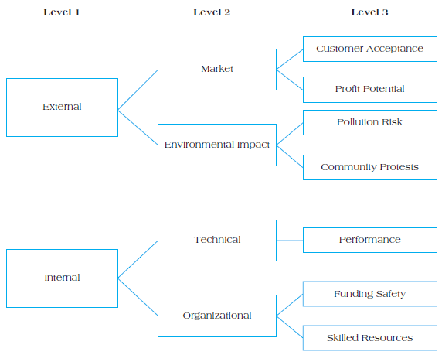
Figure 7.4 Risk Breakdown Structure (R B S)

Slide 10
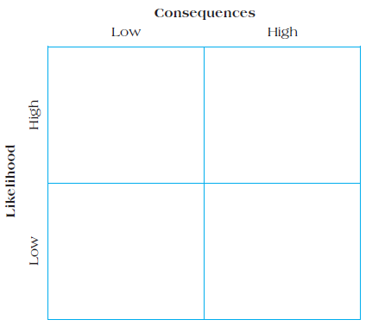
Figure 7.5 Risk Impact Matrix

Slide 11
Risk Mitigation Strategies
Accept
Minimize
Share
Transfer
Contingency Reserves
Task contingency
Managerial contingency
Insurance
Workaround
Other Mitigation Strategies
Mentoring
Cross training
Control and Documentation
Change management

Slide 12
Control and Documentation
Helps managers classify and codify risks, responses, and outcomes
Change management report system answers:
What?
Who?
When?
Why?
How?

Slide 13
Project Risk Analysis and Management (P R A M)
P R A M presents a generic methodology that can be applied to multiple project environments, and encompasses the key components of project risk management.
Key Features of P R A M
Risk management follows a life cycle.
Risk management strategy changes over the project life cycle.
Synthesized, coherent approach.

Slide 14
Nine Phases of Risk Assessment
Define
Focus
Identify
Structure
Clarify ownership of risks
Estimate
Evaluate
Plan
Manage

Slide 15
Summary
Define project risk.
Recognize the four key stages in project risk management and the steps necessary to manage risk.
Explain the Project Risk Analysis and Management (P R A M) process.

Slide 16
Thank You

